Slide 1
Combinational Building Blocks

Slide 2
Index
Building Blocks
Multiplexer
Decoders
Adders
Subtractor
Comparators
Arithmetic/Logical Unit (ALU)
Shifters and Rotators
Multiplier and divider
Floating-Point Addition

Slide 3
Building Blocks
Combinational logic is often grouped into larger building blocks to build more complex systems
principles of abstraction, hierarchy, modularity, and regularity
hiding the unnecessary gate-level details to emphasize the function of the building block
hierarchically assembled from simpler components
a well-defined interface and can be treated as a black box
Examples:
seven-segment display decoders (already considered)
multiplexers
decoders
arithmetic circuits
We will use many of these building blocks to build a microprocessor

Slide 4
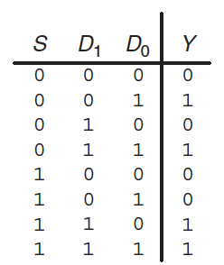
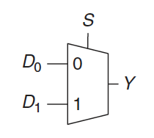
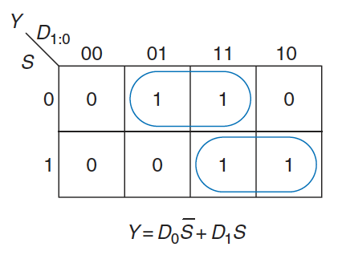
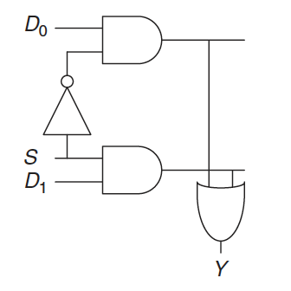
Multiplexer (mux)
A device that choose an output among several possible inputs, based on the value of a select signal
A 2:1 multiplexer has two data inputs and one output and a select signals
if S=0, Y=D₀,
if S=1, Y=D₁

Slide 5
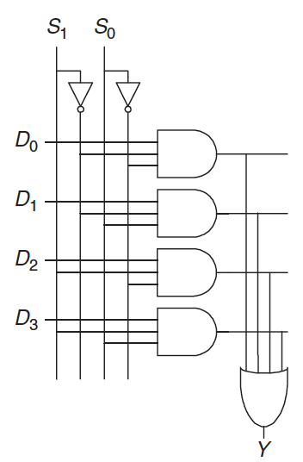
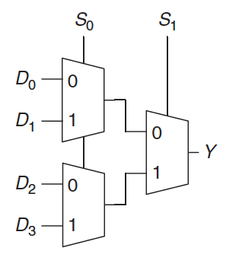
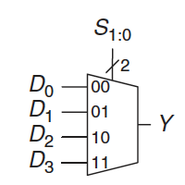
Wider multiplexer
A 4:1 multiplexer has four data inputs and one output and two select signals are needed to choose among the four data inputs
it can be built using sum-of-product logic, or multiple 2:1 multiplexers
Wider multiplexers (8:1 and 16:1) can be built by expanding the method
in general, an N:1 multiplexer needs log₂N select lines

Slide 6
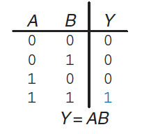
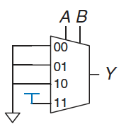
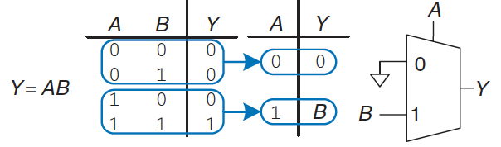
Multiplexer Logic (1)
Multiplexers can be used as lookup tables to perform logic functions
For example, we can use a multiplexer to implement a two-input AND gate
A and B serve as select lines
inputs are connected to 0 or 1, according to the corresponding row of the truth table
changing the data inputs, the multiplexer can be reprogrammed to perform a different function
In general, a 2^{N}-input multiplexer can be programmed to perform any N-input logic function by applying 0 and 1 to the appropriate data inputs
We can also cut the multiplexer size in half, using only a 2^{N–1}-input multiplexer to perform any N-input logic function
provide one of the literals to the multiplexer inputs:

Slide 7

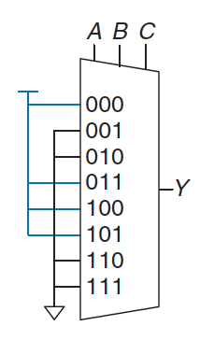
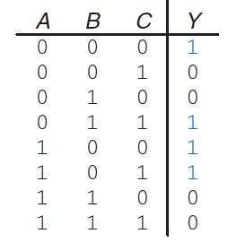
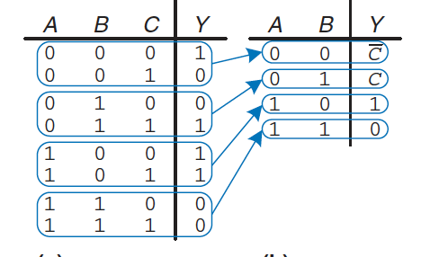
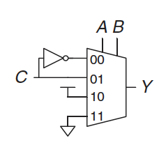
Multiplexer Logic (2)
As an example, implement the following function using a 8:1 multiplexer and a 4:1 multiplexer:

Slide 8
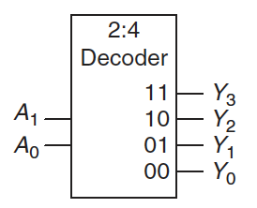
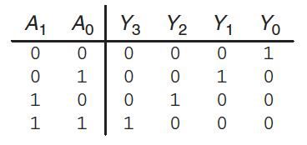
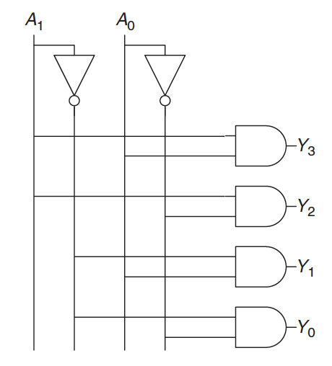
Decoders
A device with N inputs and 2^{N} outputs that asserts exactly one of its outputs depending on the input combination
For example, consider a 2:4 decoder
when A_{1:0} = 00, Y₀ is 1
when A_{1:0} = 01, Y₁ is 1
and so forth
The outputs are called one-hot
because exactly one is “hot” (HIGH) at a given time
In the implementation, each gate depends on either the true or the complementary form of each input
an N:2^{N} decoder can be constructed from 2^{N} N-input AND gates that accept the various combinations of true or complementary inputs
each output in a decoder represents a single minterm
for example, Y0 represents the minterm A₁ A₀.

Slide 9
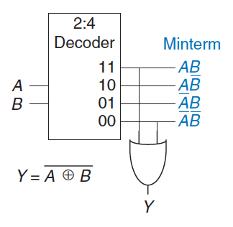
Decoder Logic
Decoders can be combined with OR gates to build logic functions
because each output of a decoder represents a single minterm, the function is built as the OR of all of the minterms in the function
example: a two-input XNOR function using a 2:4 decoder and a single OR gate
An N-input function with M 1’s in the truth table can be built with an N:2N decoder and an M-input OR.
This concept will be applied to the building of read-only memories (ROMs)

Slide 10
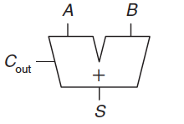
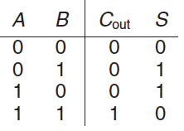


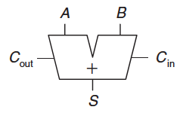
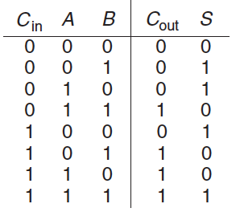


Half and Full Adders
Addition is one of the most common operations in digital systems
Half adder
two inputs, A and B, and two outputs, S and C_{out}
S is the sum of A and B
C is the eventual carry out
In a multi-bit adder, C_{out} is added (carried) in to the next most significant bit
half adder lacks a C_{in} input to accept the C_{out} of the previous column.
Full Adder
accepts also the carry in C_{in}

Slide 11
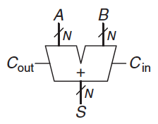
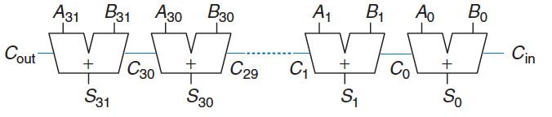
Carry Propagate Adder
A N-bit adder that sums two N-bit inputs and a carry in to produce an N-bit result S and a carry out
the carry out of one bit propagates into the next bit
drawn like a full adder except that input/output are busses rather than single bits
The simplest way to build it is to chain together N full adders
C_{out} of one stage acts as the C_{in} of the next stage
Ripple-Carry Adder
A good application of modularity and regularity
full adder module is reused many times to form a larger system
It is slow when N is large.
S₃₁ depends on C₃₀, which depends on C₂₉, and so forth
the delay of the adder t_{riple} = N * t_{FA} grows directly with the number of bits

Slide 12
Carry-Lookahead Adder (1)
Ripple-Carry Adders are slow because the carry must propagate
We can divide the adder into blocks and determine the carry out of a block as soon as the carry in is known
it looks ahead across the blocks rather than wait to ripple through all the full adders
CLA use generate (G) and propagate (P) signals
a column i “generates” a carry if it produces a carry independent of the carry in
both input are 1: G_{i} = A_{i} AND B_{i}
a column i “propagates” a carry if it produces a carry whenever there is a carry in
either one of the input is 1: P_{i} = A_{i} OR B_{i}
Using this definition, a column i will generate a carry out if it either generates or propagates a carry:
C_{i} = G_{i} + P_{i} C_{i-1} = A_{i} B_{i} + (A_{i} + B_{i}) C_{i-1}

Slide 13
Carry-Lookahead Adder (2)
We can extend to multiple-bit blocks
a block “generates” a carry if it produces a carry out independent of the carry in
a block “propagate” a carry if it produces a carry out whenever there is a carry in
We define block generate and propagate signals
G_{i:j} and P_{i:j} for blocks spanning columns i through j
A block generates a carry…
…if the most significant column generates a carry
…if the previous column generated a carry and the most significant column propagates it, and so forth
G_{3:0} = G₃ + P₃(G₂ + P₂(G₁ + P₁G₀)
A block propagates a carry….
if all the columns in the block propagate the carry
P_{3:0} = P₃P₂P₁P₀
We can quickly compute the carry out of the block i
Ci = G_{i:j} + P_{i:j}C_{j-1}

Slide 14
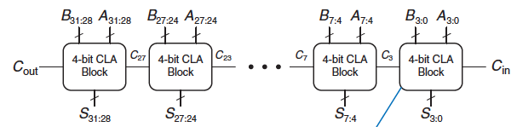
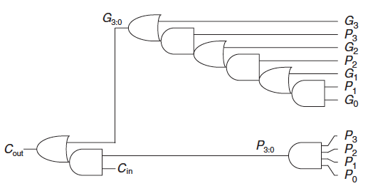
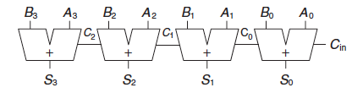
Carry-Lookahead Adder (2)
A 32-bit carry-lookahead adder composed of eight 4-bit blocks
Each block contains a 4-bit ripple-carry adder and lookahead logic to compute the carry out of the block given the carry in
Logic gates needed to compute the column generate and propagate signals, Gi and Pi , using signals Ai and Bi

Slide 15
Carry-Lookahead Adder (3)
All blocks compute column generate and propagate signals simultaneously
Then C_{in} advances directly to C_{out} through each block until the last
C_{in} proceeds through the lookahead gates to produce C₃
C₃ proceeds through its lookahead block to produce C₇
C₇ proceeds through its lookahead block to produce C₁₁
and so on until C₂₇, the carry in to the last block
finally, the last block contains a short ripple-carry adder (no more the lookahead logic)
An N-bit adder divided into k-bit blocks has a delay
t_{CLA} = t_{pg} + t_{pg_block} + (N/k -1) t_{lookahead} + k t_{FA}
t_{pg} is the delay to generate signals P_{i} and G_{i}
t_{pg_block} is the delay to to generate signals P_{i:j} and G_{i:j} for a k-bit block
t_{lookahead} is the delay from C_{in} to C_{out} through the logic of the k-bit CLA block
For N > 16, the carry-lookahead adder is much faster than the ripple-carry adder
however, the adder delay still increases linearly with N

Slide 16
Ripple-Carry Adder vs Carry-Lookahead Adder
Compare the delays of a 32-bit ripple-carry adder and a 32-bit carry-lookahead adder with 4-bit blocks
Assume that each gate delay is 100ps and that a full adder delay is 300ps
The propagation delay of the 32-bit ripple-carry adder is
t_{riple} = N * T_{FA} = 32 * 300ps = 9.6 ns
The carry-lookahead adder has
t_{pg} = 100ps (one AND or one OR)
t_{pg_block} = 6 * 100 ps = 600ps (six AND/OR gates)
t_{lookahead} = 2 * 100 ps = 200ps (one OR and one AND)
t_{CLA}=t_{pg}+t_{pg_block}+(N/k-1)t_{lookahead}+kt_{FA} = 100 + 600 + (32/4 - 1)*200 + 4*300 = 3.3ns
The carry-lookahead adder is almost 3 times faster than the ripple-carry adder
Faster adders require more hardware and therefore are more expensive and power-hungry
these trade-offs must be considered when choosing an appropriate adder for a design

Slide 17
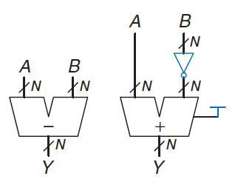
Subtractor
Performed by taking the two’s complement of the second number, then adding
To compute Y = A − B
first create the two’s complement of B
invert the bits of B to obtain B
add 1 to get −B = B + 1
add this quantity to A
Y = A + B + 1 = A − B
We can use a single carry-lookahead adder by adding A + B with C_{in} = 1

Slide 18
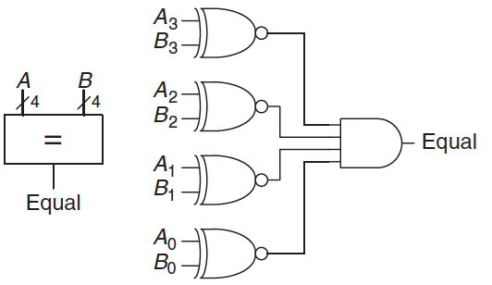
Comparators (1)
Determines whether two binary numbers are equal or if one is greater or less than the other
receives two N-bit binary numbers A and B
an equality comparator produces a single output, indicating A is equal to B
a magnitude comparator produces one or more outputs, indicating the relative values of A and B
The equality comparator is the simpler piece of hardware
it checks whether the corresponding bits in each column of A and B are equal
using XNOR gates
the numbers are equal if all of the columns are equal

Slide 19
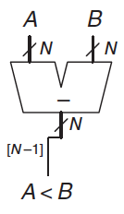
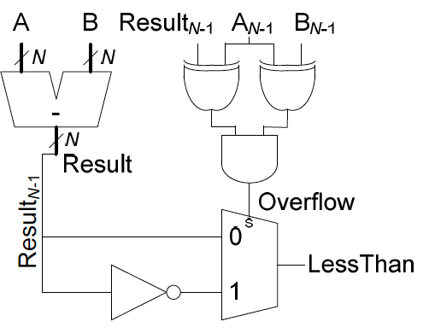

Comparators (2)
Magnitude comparison of signed numbers is usually done by computing A − B and looking at the sign (most significant bit) of the result
if the result is negative (i.e., the sign bit is 1), then A is less than B
otherwise, A is greater than or equal to B
This comparator functions incorrectly upon overflow
overflow occurs when the two inputs have different signs and the sign of the subtraction result has a different sign than the A input

Slide 20
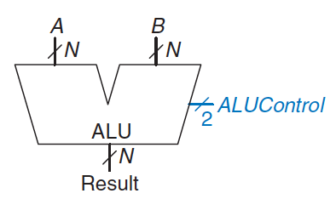
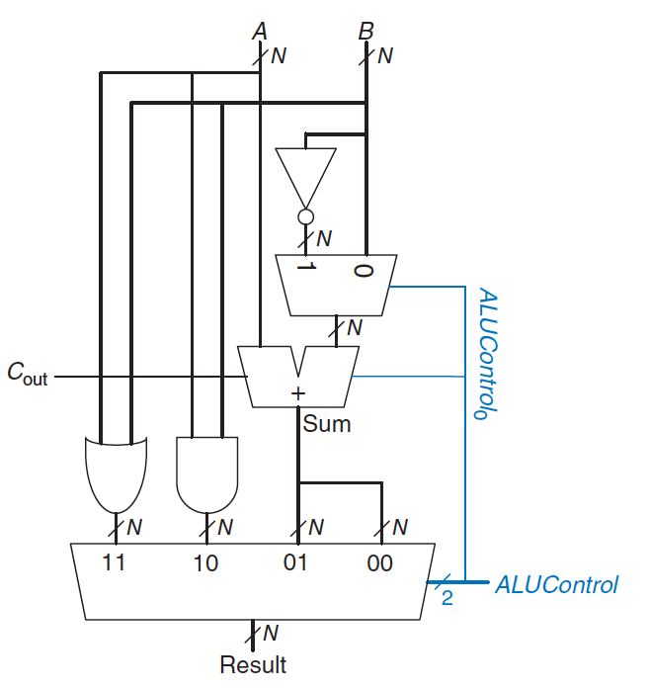
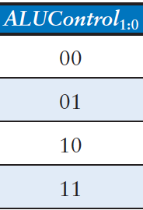
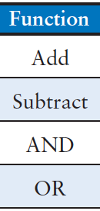
Arithmetic/Logical Unit (1)
ALU combines a variety of mathematical and logical operations into a single unit
addition, subtraction, AND, and OR operations
control signal to specifies the function to perform
the heart of most computer systems
The following implementation contains
an N-bit adder, N 2-input AND and OR gates
More specifically
if ALU_{Control}=00, the multiplexer chooses A + B
If ALU_{Control}=01, the ALU computes A − B
If ALU_{Control}=10, the ALU computes A AND B
If ALU_{Control}=11 the ALU performs A OR B

Slide 21
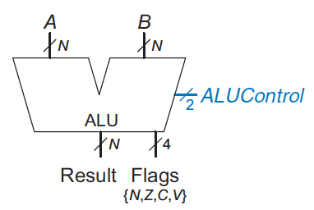
Arithmetic/Logical Unit (2)
ALU can produce flags to provide information about the result
Z (zero)
all of the bits of the output are 0
N (negative)
the most significant bit of the output
C (carry)
adder produces a carry out and the ALU is performing addition or subtraction
V (overflow)
overflow occurs when the addition of two same signed numbers produces a result with the opposite sign
ALU is performing addition or subtraction (ALU_{Control1}=0)
A and Sum have opposite signs
A and B have the same sign and the adder is performing addition (ALU_{Control0}=0)
or A and B have opposite signs and the adder is performing subtraction (ALU_{Control0}=1)

Slide 22
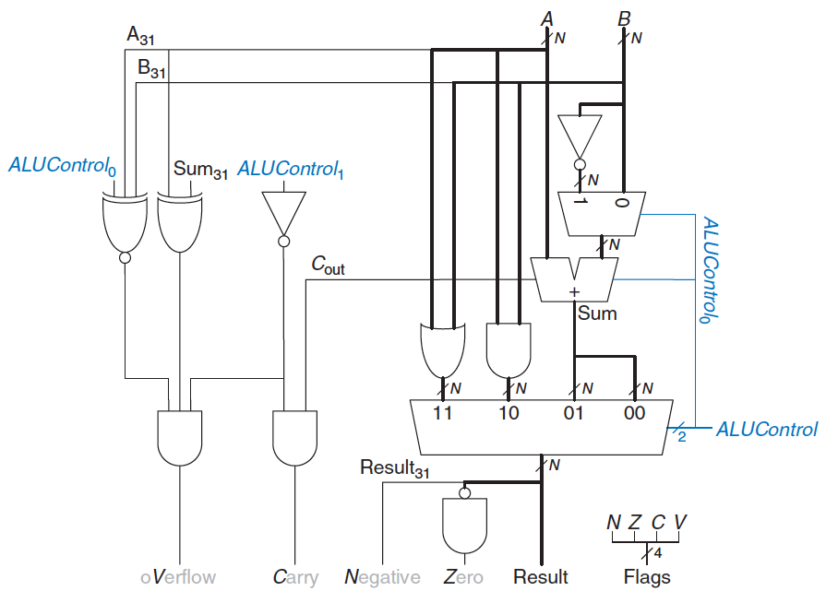
Arithmetic/Logical Unit (3)

Slide 23
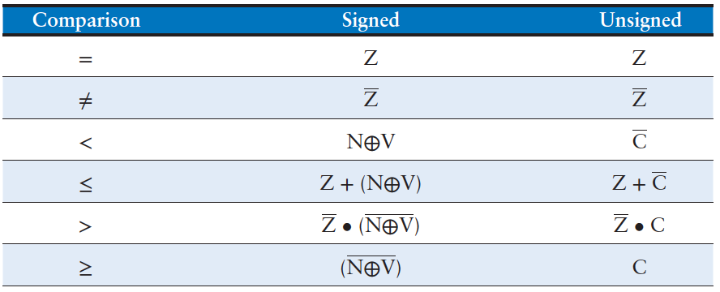
Arithmetic/Logical Unit (4)
The ALU flags can also be used for comparisons
if Z is asserted, the result is 0, so A = B. Otherwise, A is not equal to B
magnitude comparison is messier and depends on whether the numbers are signed or unsigned
Many variations on this basic ALU exist that support other functions

Slide 24
Shifters (1)
Shifters move bits
logical shifter (>> <<): shifts the number to the left or right and fills empty spots with 0
11001 >> 2 = 00110; 11001 << 2 = 00100
arithmetic shifter (>>> <<<): on right shifts fills the most significant bits with a copy of the old most significant bit (msb)
useful for multiplying and dividing signed numbers
11001 >>> 2 = 11110; 11001 << 2 = 00100
A left shift is a special case of multiplication
a left shift by N bits multiplies the number by 2^{N}
000011₂ << 4 = 110000₂ is equivalent to 3₁₀ × 2⁴ = 48₁₀
An arithmetic right shift is a special case of division
an arithmetic right shift by N bits divides the number by 2^{N}
11100₂ >>> 2 = 11111₂ is equivalent to −4₁₀/2² = −1₁₀

Slide 25
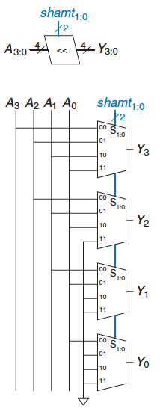
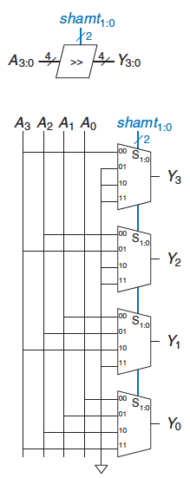
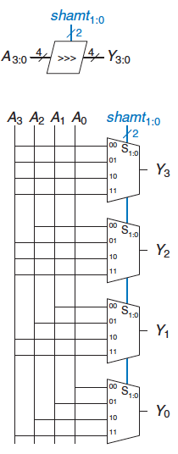
Shifters (2)
An N-bit shifter can be built from N N:1 multiplexers
depending on the value of a 2-bit shift amount control signal, the output receives the input shifted by 0 to 3 bits

Slide 26
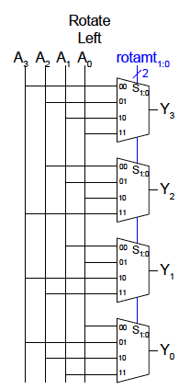
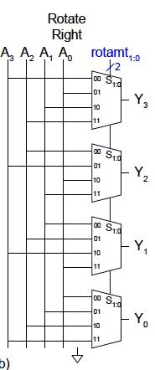
Rotators
Rotator rotates (left or right) a number in a circle such that empty spots are filled with bits shifted off the other end
11001 ROR 2 = 01110
11001 ROL 2 = 00111

Slide 27
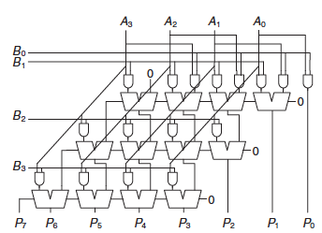

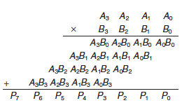
Multiplier
A N×N multiplier multiplies two N-bit numbers and produces a 2N-bit result
multiplication of 1-bit binary numbers is equivalent to the AND operation
AND gates are used to form the partial products
Considering an unsigned 4 × 4 multiplier
partial product is a single multiplier bit (B₃, B₂,…) AND the multiplicand bits (A₃, A₂,…)
partial product is added to the shifted next partial product
B₀ AND (A₃, A₂, A₁, A₀) is added to B₁ AND (A₃, A₂, A₁, A₀)
subsequent rows form and add the remaining partial product
For N-bit operands, there are N partial products and N − 1 stages of 1-bit adders

Slide 28
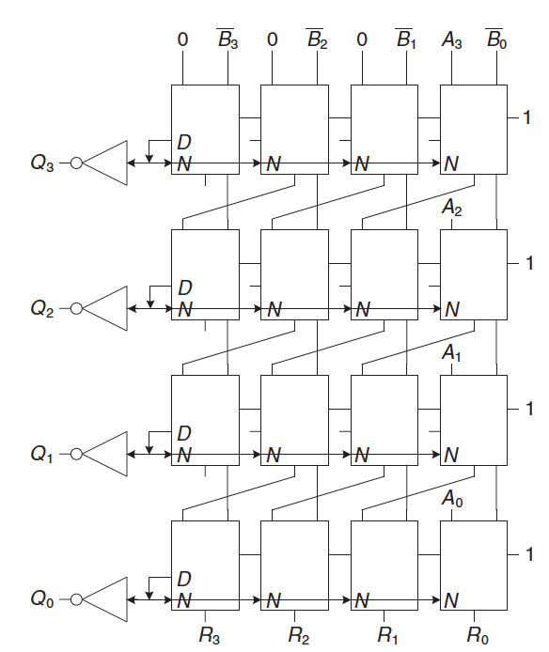
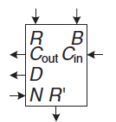
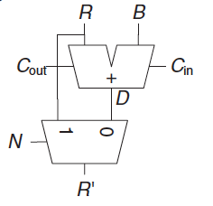
Division
The most complex operation to perform among all the arithmetic operations
it should be used as infrequently as possible
A/B = Q + R/B
Numerous research works have been carried out to efficiently implement the division operation
for the implementation, recall that R+B+1 = R−B
The delay increases proportionally to N²
R′ = 0
for i = N−1 to 0
R = {R′ << 1, Ai}
D = R − B
if D < 0 then
Qi = 0,
R′ = R
else
Qi = 1,
R′ = D
R = R′

Slide 29
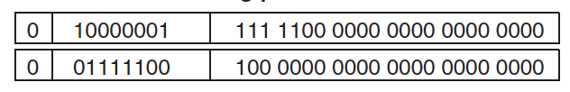


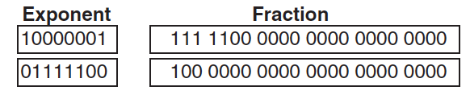






Floating-Point Addition (1)
1. Extract exponent and fraction bits
2. Prepend leading 1 to form the mantissa
3. Compare exponents
4. Shift smaller mantissa if necessary
5. Add mantissas
6. Normalize mantissa and adjust exponent if necessary
7. Round result
8. Assemble exponent and fraction back into floating-point number

Slide 30
Floating-Point Addition (2)
Floating-point arithmetic is usually done in hardware to make it fast
floating-point unit (FPU)
typically distinct from the central processing unit (CPU)
The infamous floating-point division bug in the Pentium FPU cost Intel $475 million to recall and replace defective chips

Slide 31



Exercises (1)
Ex1: Implement the following function using (a) an 8:1 multiplexer, (b) a 4:1 multiplexer and one inverter, and (c) a 2:1 multiplexer and two other logic gates
Solution:

Slide 32


Exercises (2)
Ex2: Implement the following function using (a) an 8:1 multiplexer, (b) a 4:1 multiplexer and no other gates, and (c) a 2:1 multiplexer, one OR gate, and an inverter
Solution:

Slide 33



Exercises (3)
Ex3: Design the following comparators for 32-bit unsigned numbers and sketch the schematics: (a) not equal, (b) greater than or equal to, (c) less than
Solution:

